Slide 2
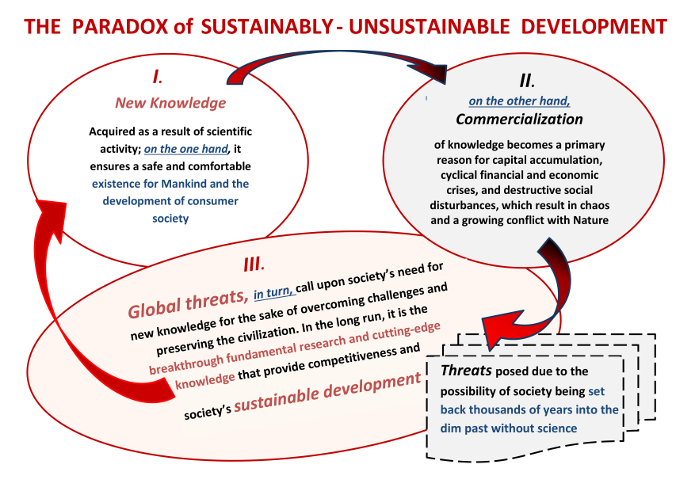

Slide 6
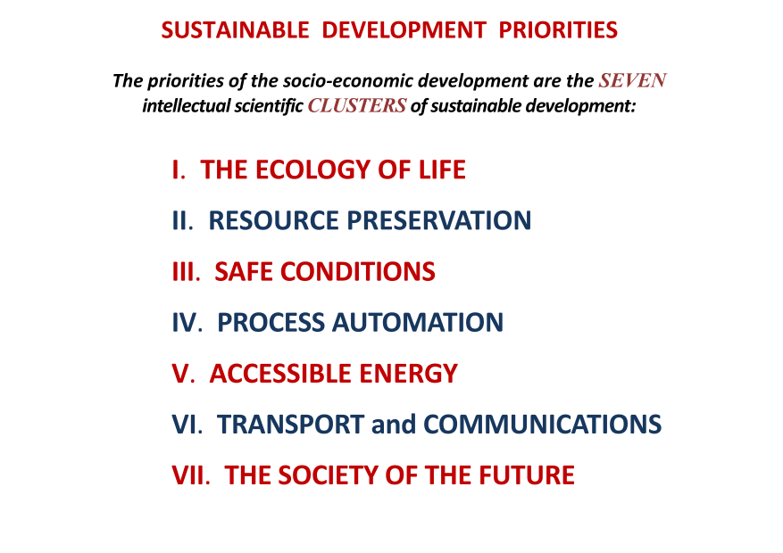

Slide 16
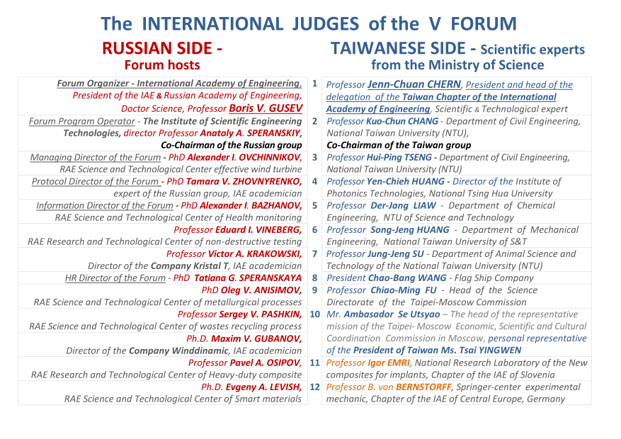

Slide 22
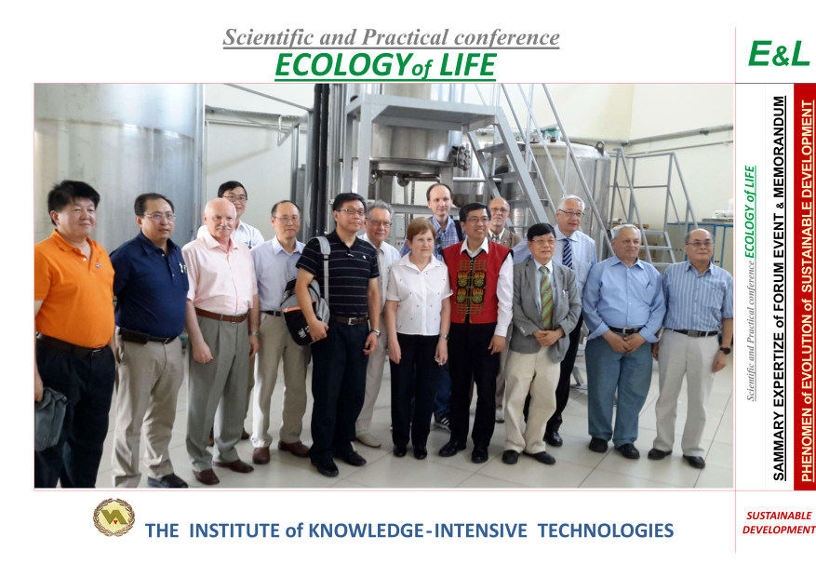

Slide 25
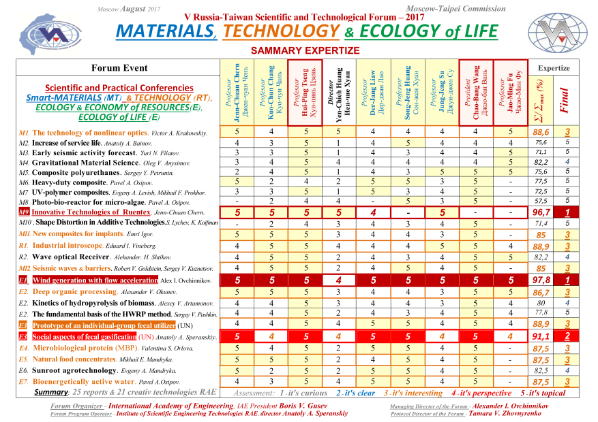

Slide 30
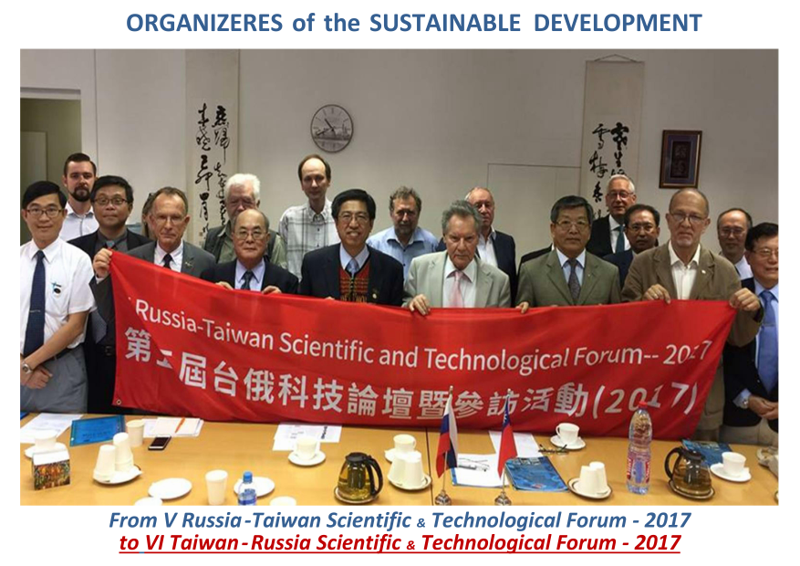

Slide 34
№ 1
R A E + T C I A E
+ C E C I + N T U
Professor Kuo-Chun Chang - Department of Civil Engineering,

Slide 45
№ 2
RA E + T C I A E + N T U
Professor Jung-Jeng Su - Department of Animal Science and Technology

Slide 46
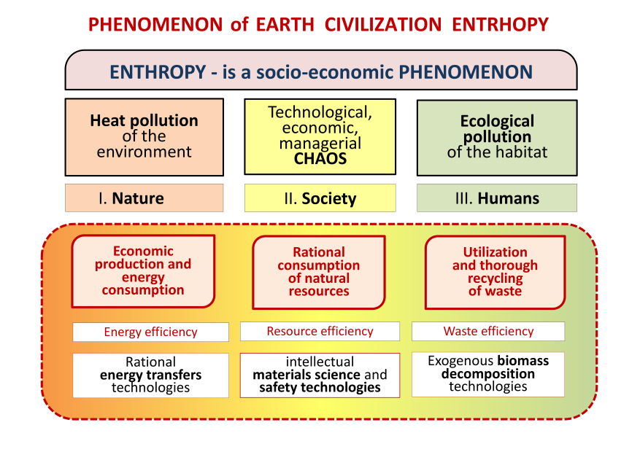

Slide 47
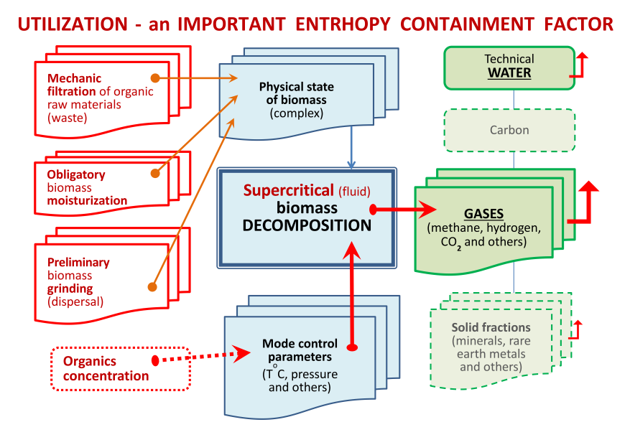

Slide 54
2007
2017

